Slide 1
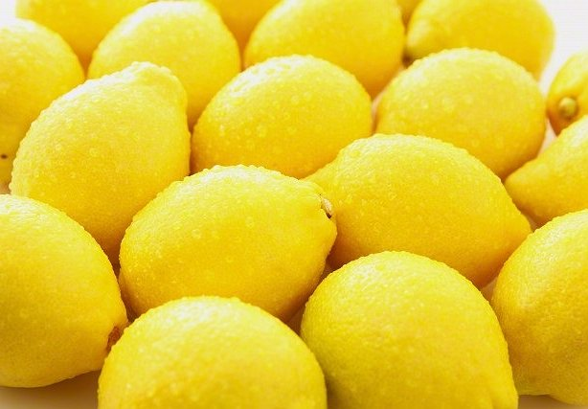
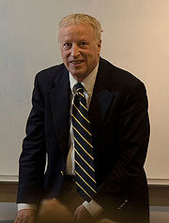
THE MARKET FOR "LEMONS": QUALITY UNCERTAINTY AND THE MARKET MECHANISM
George A. Akerlof (1970)

Slide 2
Brief summary
The paper relates quality and uncertainty and investigates the adverse selection problem.
Explores the interaction of quality differences and uncertainty in explaining important market equilibria.
Applies the findings to a series of economic situations, ranging from insurance contracts to employment and credit decisions.

Slide 3
Structure of the main reasoning
“There are many markets in which buyers use some market statistic to judge the quality of prospective purchases.
In this case there is incentive for sellers to market poor quality merchandise, since the returns for good quality accrue mainly to the entire group whose statistic is affected rather than to the individual seller.
As a result, there tends to be a reduction in the average quality of goods and in the size of the market.”
Assumption
Individual Incentives
Market Equilibrium

Slide 4
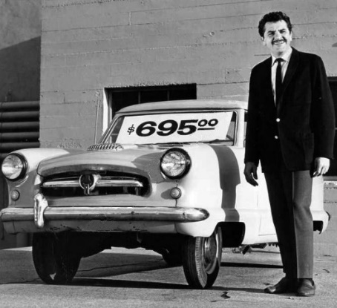
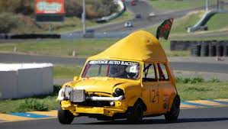
Example: the automobile market
Large price difference between new cars and those that have just left the showroom (old).
After owning a specific car for a length of time, the car owner can form a good idea of its quality (good or bad).
An asymmetry in available information has developed: for the sellers now have more knowledge about the quality of a car than the buyers.
or

Slide 5
Gresham’s law
“Bad money drives out good.”
Because bad cars sell at the same prices as good cars:
It is impossible for a buyer to tell the difference between a good car and a bad car; only the seller knows.
Information asymmetry exists.
Most cars traded will be the “lemons,” and good cars may not be traded at all.
→ Bad cars tend to drive out the good.

Slide 6
Illustrative example
Imagine that owners of lemons (bad cars) are willing to sell for $1000 and owners of plums (good cars) are willing to sell for $2000.
Imagine that purchasers are willing to pay up to $1200 for a lemon and up to $2400 for a plum.
Assume that sellers know what kind of car they have, but buyers can't tell; all buyers know is that half of all used cars are lemons.
Therefore, based on the expected probability that a given car is a lemon, they will pay only up to $1800 for any car (1/2*1200 + 1/2*2400).

Slide 7
Illustrative example
I am uncertain about the quality of cars , so I will not pay a premium
But plum owners aren't willing to sell for only $1800, so only lemon owners will sell. → The logical conclusion is that only the lemons will be sold.
The mere presence of inferior goods destroys the market for quality goods when information is imperfect/asymmetric.
Plum owners need some way of signalling their car's quality.

Slide 8
Model structure
Demand: Q_{d} = D (p, $μ$) , where average quality: $μ$ = $μ$(p)
Supply: S = S(p)
In equilibrium, Supply = Demand for the given average quality, such that:
S(p) = D(p, $μ$(p))
U₁ = M + $\sum_{i=1}^{n}{x_{i}}$
U₂ = M + $\sum_{i=1}^{n}{{3/2x}_{i}}$
Assumptions:
Both types of traders are von Neumann–Morgenstern expected utility maximizers;
Group one has N cars with uniformly distributed quality x, where 0 < x < 2; and group two has no cars;
The price of M (other goods) is unity.
, where M is the consumption of goods other than automobiles, x_{i} is the quality of the i^{th} automobile, and n is the number of automobiles.
Utilities

Slide 9
Model with Information Symmetry
Supply
Demand
There is no equilibrium when p > 3/2, because group 1 is willing to sell their car, but no group is willing to buy, since the reservation price of group 2 is only 3/2 and group 1 is only 1.
When p = 3/2, only group 2 wants to buy.
When p < 1, the equilibrium doesn't exist, since group 1 doesn't want to supply/sell their cars.

Slide 10
Model with Information Asymmetry
Demand-Supply for group 1
Demand-Supply for group 2
But at price p, the average quality is p/2. Under this condition, demand is never met.
The price would go down, which further drives some sellers out of the market and further lowers down the average quality of cars, leading to the shrinking of the market.

Slide 11
Application: Insurance
Little market for insurance of those over 65. Why?
Under information asymmetry, insurance providers cannot discern between types of applicants (healthy vs unhealthy).
Why doesn't the price rise to match the risk?
As the price level rises, the people who insure themselves will be those who are increasingly certain that they will need the insurance (adverse selection from the buyers).
This action could leave an insurer with an undue proportion of below average risks, and claims might be higher than anticipated.
One possible solution is group insurance, but it is available only to those fit enough to be employed (adverse selection from the supplier).
In equilibrium, medical insurance is least available to those who need it most.

Slide 12
Application: Employment of Minorities
Argument that race may serve as a good statistic for the applicant's social background, quality of schooling, and general job capabilities.
The fact that some demographic groups are preferred to others is because employers make judgments about the average behavior of an observable group of people.
Quality schooling may be a substitute for this statistic.
Workers with high ability have lower costs of pursuing attainment of education at higher levels, which can act as a signal of their productive capacity.
Signaling

Slide 13
Application: Cost of Dishonesty
In the example for the used car market, there is an incentive for the sellers to offer lemons at the market price (dishonest behavior). Two main consequences:
Lowering of the expected quality of a good from the perspective of consumers;
Driving legitimate goods out of business.
The cost of dishonesty resides not only in the amount by which the purchaser is cheated but also the cost of loss incurred from driving legitimate business out of existence.

Slide 14
Application: Credit Market
Ex 1. In India, a major fraction of industrial enterprise is controlled by managing agencies.
Managing agencies increase venture’s reputation, facilitating access to investment;
As an alternative to reputation, community ties can also help in accessing capital.
If there were symmetric information, investors would immediately know whether or not a venture was worth investing in, and there would be no need for additional spending on a managing agency to draw in more investment.
Ex 2. credit is usually provided by two main types of intermediaries:
Moneylenders who charge extortionate interest rates, or;
Banks organized through a Cooperative Movement to provide credit at lower rates.
Central Bank has easy means of enforcing contracts in banks & Moneylender has knowledge of the borrower’s attributes.
Anyone else in the middle captures all the high-risk borrowers (lemons) and will make losses.
Screening

Slide 15
Conclusion
The difficulty of distinguishing good quality from bad is inherent in the business world.
Informal unwritten guarantees are preconditions for trade and production.
Where these guarantees are indefinite, business will suffer.
Institutions arise to counteract the effects of quality uncertainty:
Guarantees, warranties, brand names, chains, licensing.
Signaling and Screening

